Slide 1


Cryptography & Network Security
Lecture Slide 1
CSE Department
University of Engineering & Management, Kolkata

Slide 2

Topics to be Covered
Security
Security Threats
Security Mechanism
Security Services
Cryptography?

Slide 3

Security
Computer data often travels from one computer to another, leaving the safety of its protected physical surroundings. Once the data is out of hand, people with bad intention could modify or forge your data, either for amusement or for their own benefit.
Cryptography can reformat and transform our data, making it safer on its trip between computers. The technology is based on the essentials of secret codes, augmented by modern mathematics that protects our data in powerful ways.

Slide 4

Computer Security - generic name for the collection of tools designed to protect data and from the hackers
Network Security - measures to protect data during their transmission
Internet Security - measures to protect data during their transmission over a collection of interconnected networks.

Slide 5
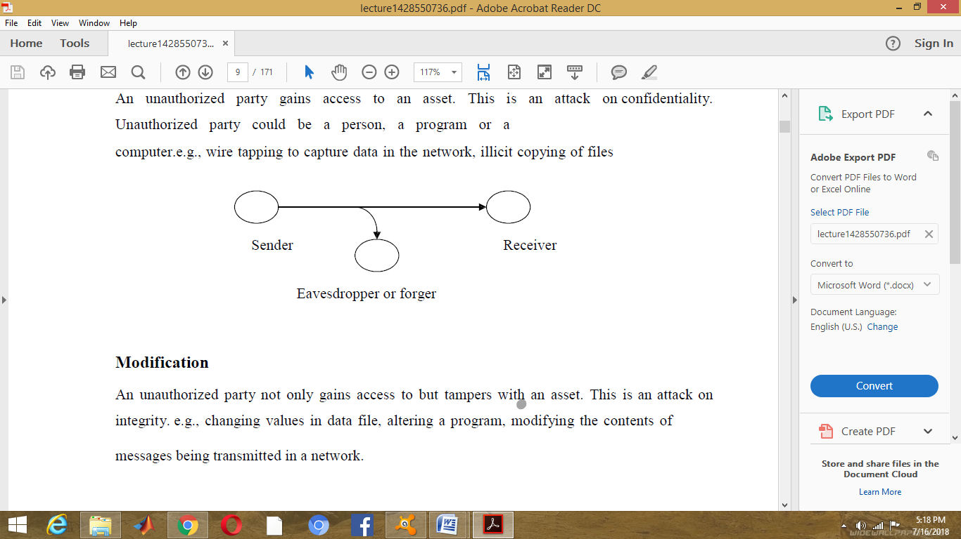

Security Attacks / Threats
There are four general categories of attack which are listed below.
1. Interruption
An asset of the system is destroyed or becomes unavailable or unusable. This is an attack on availability e.g., destruction of piece of hardware, cutting of a communication line or Disabling of file management system.
2. Interception
An unauthorized party gains access to an asset. This is an attack on confidentiality. Unauthorized party could be a person, a program or a computer .e.g., wire tapping to capture data in the network, illicit copying of files.

Slide 6
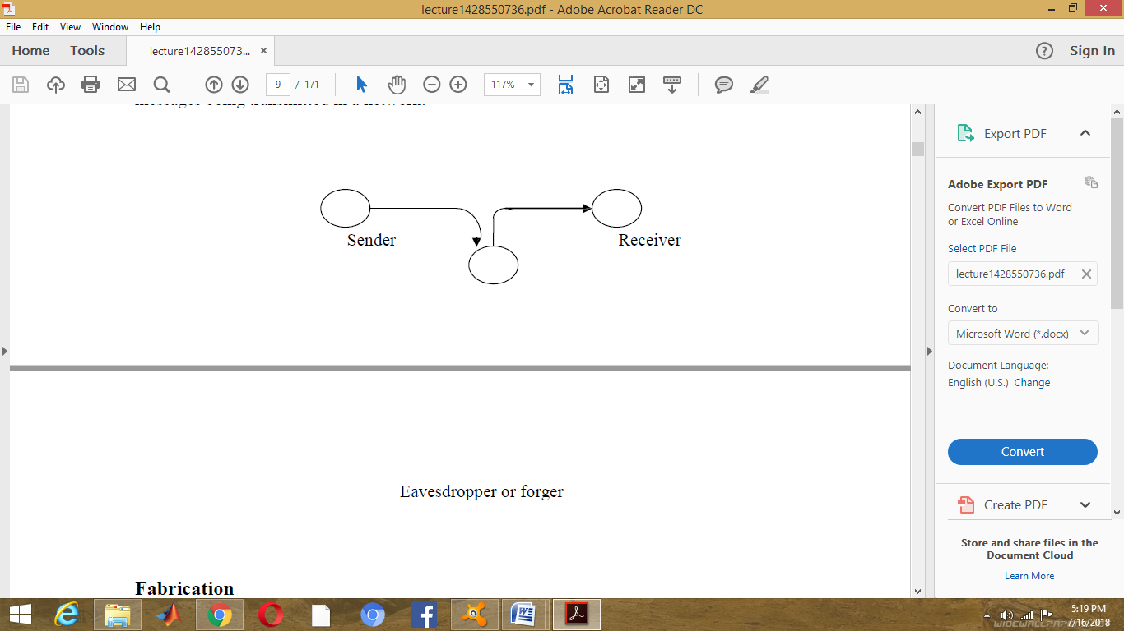
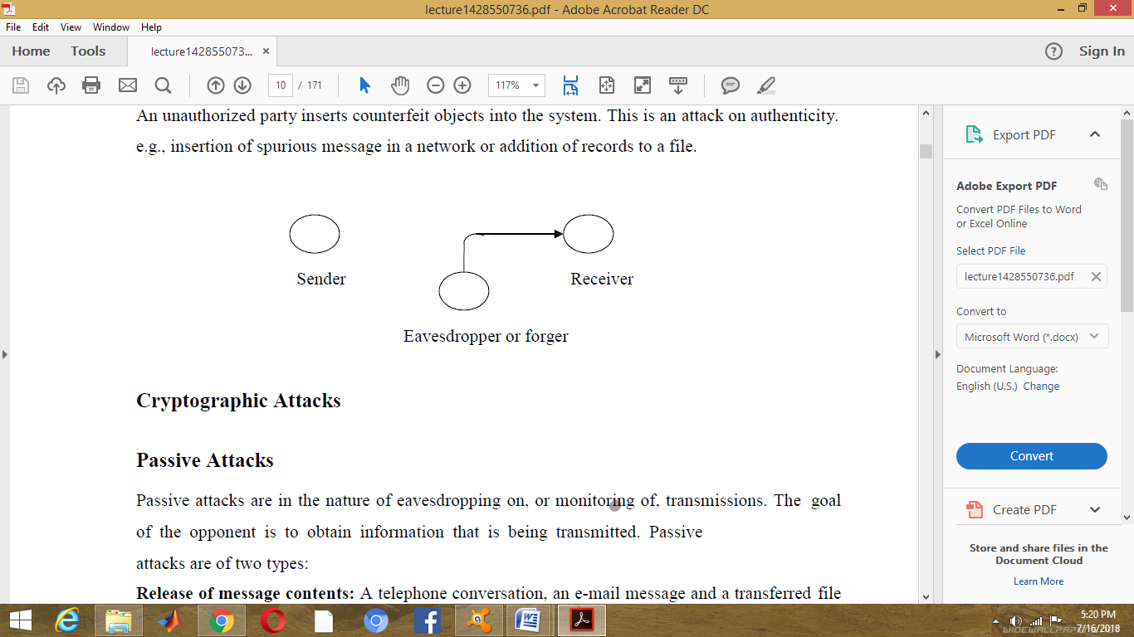
3. Modification
An unauthorized party not only gains access to but tampers with an asset. This is an attack on integrity. e.g., changing values in data file, altering a program, modifying the contents of messages being transmitted in a network.
4. Fabrication
An unauthorized party inserts counterfeit objects into the system. This is an attack on authenticity. e.g., insertion of spurious message in a network or addition of records to a file.

Slide 7

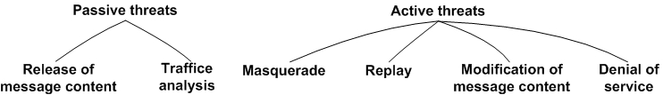
Cryptographic Attacks

Slide 8
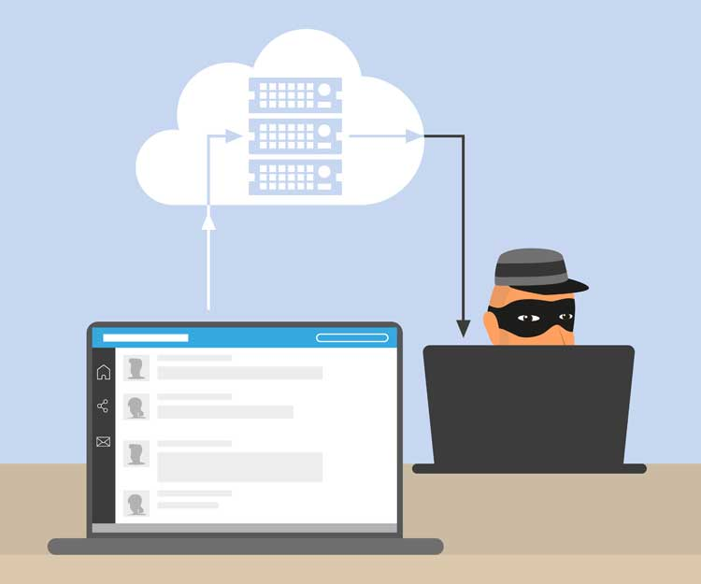
Passive Attacks
Passive attacks are in the nature of eavesdropping on, or monitoring of, transmissions. The goal of the opponent is to obtain information that is being transmitted. Passive attacks are of two types:
Release of message contents: A telephone conversation, an e-mail message and a transferred file may contain sensitive or confidential information. We would like to prevent the opponent from learning the contents of these transmissions.
Traffic analysis: If we had encryption protection in place, an opponent might still be able to observe the pattern of the message. The opponent could determine the location and identity of communication hosts and could observe the frequency and length of messages being exchanged. This information might be useful in guessing the nature of communication that was taking place.
Passive attacks are very difficult to detect because they do not involve any alteration of data.
However, it is feasible to prevent the success of these attacks.

Slide 9

Active attacks
These attacks involve some modification of the data stream or the creation of a false stream. These attacks can be classified in to four categories:
Masquerade – One entity pretends to be a different entity.
Replay – involves passive capture of a data unit and its subsequent transmission to produce an unauthorized effect.
Modification of messages – Some portion of message is altered or the messages are delayed or recorded, to produce an unauthorized effect.
Denial of service – Prevents or inhibits the normal use or management of communication facilities. Another form of service denial is the disruption of an entire network, either by disabling the network or overloading it with messages so as to degrade performance.

Slide 10

Security Mechanism
One of the most specific security mechanisms in use is cryptographic techniques. Encryption or encryption-like transformations of information are the most common means of providing security. Some of the mechanisms are
Encipherment
Digital Signature
Access Control

Slide 11
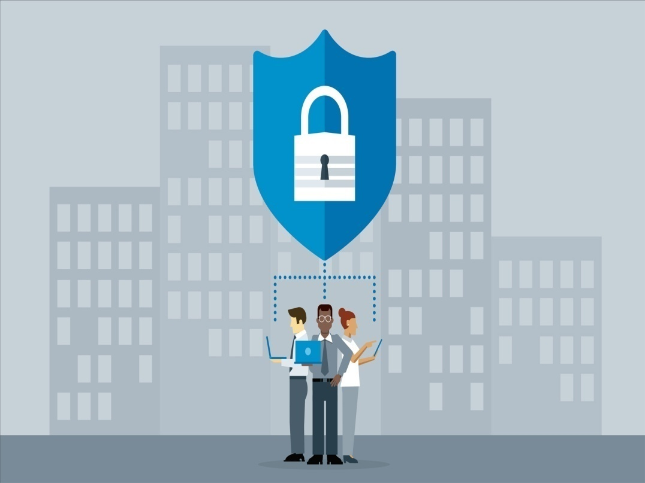
Security Services
Confidentiality: Ensures that the information in a computer system a n d transmitted information are accessible only for reading by authorized parties.
Authentication: Ensures that the origin of a message or electronic document is correctly identified, with an assurance that the identity is not false.
Integrity: Ensures that only authorized parties are able to modify computer system assets and transmitted information.
Non repudiation: Requires that neither the sender nor the receiver of a message be able to deny the transmission.
Access control: Requires that access to information resources may be controlled by or the target system.
Availability: Requires that computer system assets be available to authorized parties when needed.

Slide 12
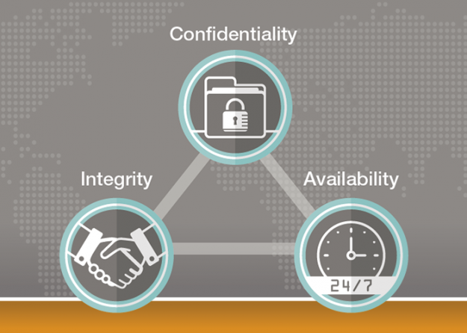
3 Pillars of Security

Slide 13
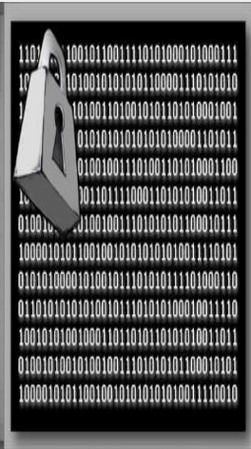
Cryptography
The art or science encompassing the principles and methods of transforming an intelligible message into one that is unintelligible, and then retransforming that message back to its original form.
In simple words, cryptography is used to transform a message which makes it more secure so that it can sustain in different attack prone areas.

Slide 14
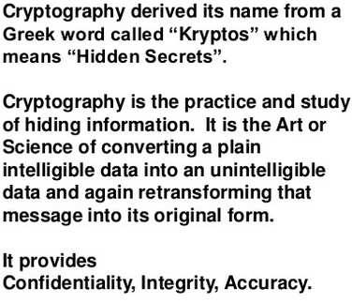
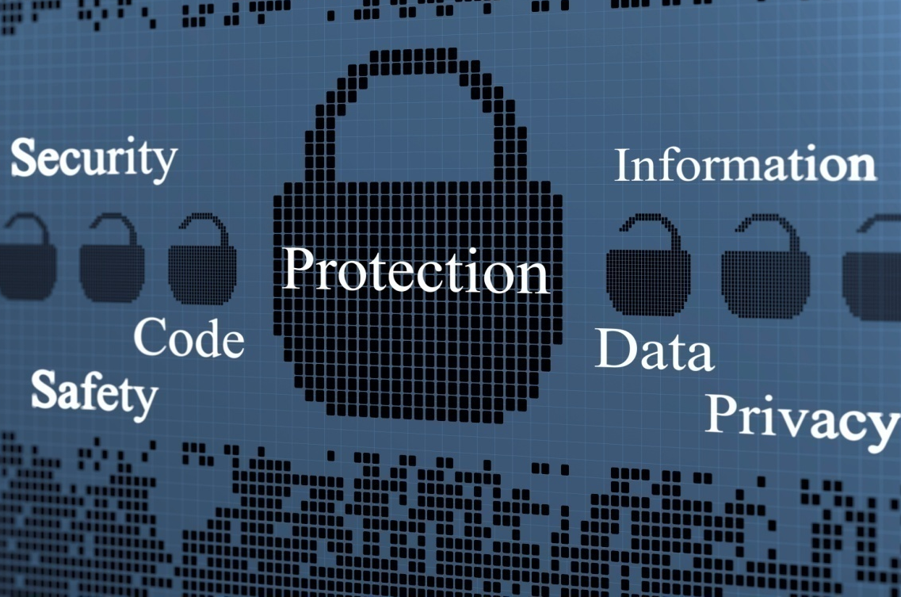
Why do we Need it?
Cryptography enables secure communications because we live in the age of information and there is distrust in this world.

Slide 15
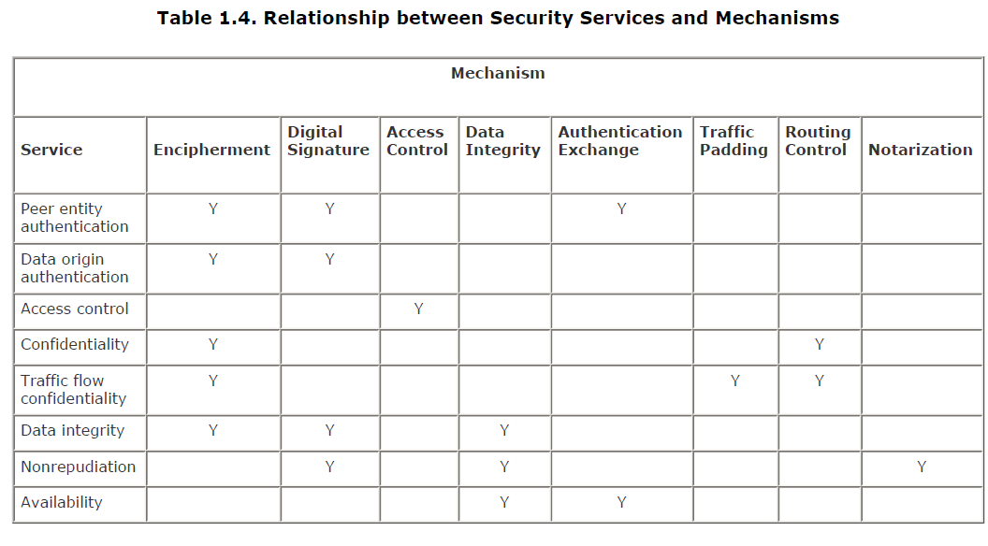

Slide 16


